Slide 1
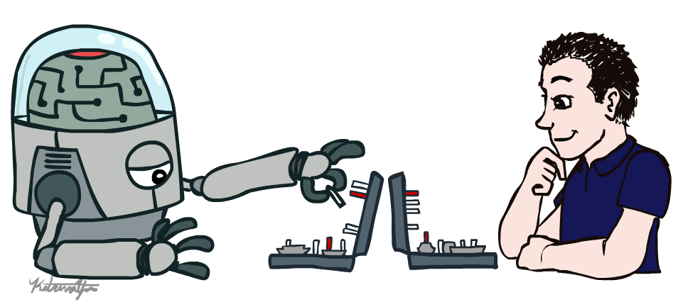
CS 188: Artificial Intelligence
Introduction
Instructors: Dan Klein and Pieter Abbeel
University of California, Berkeley
[These slides were created by Dan Klein and Pieter Abbeel for CS188 Intro to AI at UC Berkeley. All materials available at http://ai.berkeley.edu.]
Notes:
Please retain proper attribution, including the reference to ai.berkeley.edu. Thanks!

Slide 2



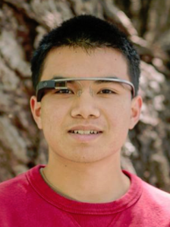

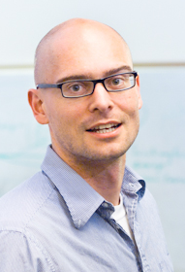
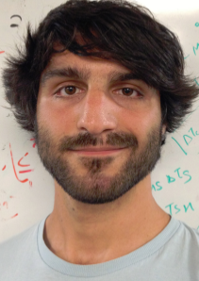



Course Staff
GSIs
Professors
John Du
James Ferguson
Sergey Karayev
Michael Liang
Dan Klein
Pieter Abbeel
Teodor Moldovan
Evan Shelhamer
Alvin Wong
Ning Zhang

Slide 3

Course Information
Communication:
Announcements on webpage
Questions? Discussion on piazza
Staff email: cs188-staff@lists
This course is webcast (Sp14 live videos)
+ Fa12 edited videos (1-11)
+ Fa13 live videos
Course technology:
New infrastructure
Autograded projects, interactive homeworks (unlimited submissions!) + regular homework
Help us make it awesome!
Sign up at: inst.eecs.berkeley.edu/~cs188

Slide 4
Course Information
Prerequisites:
(CS 61A or B) and (Math 55 or CS 70)
Strongly recommended: CS61A, CS61B and CS70
There will be a lot of math (and programming)
Work and Grading:
5 programming projects: Python, groups of 1 or 2
5 late days for semester, maximum 2 per project
~9 homework assignments:
Part 1: interactive, solve together, submit alone
Part 2: written, solve together, write up alone, electronic submission through pandagrader [these problems will be questions from past exams]
Two midterms, one final
Participation can help on margins
Fixed scale
Academic integrity policy
Contests!

Slide 5
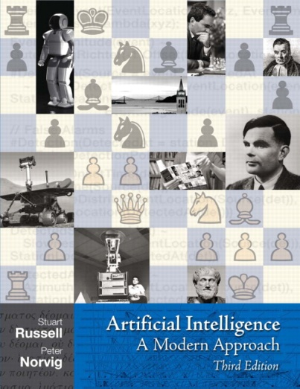
Textbook
Not required, but for students who want to read more we recommend
Russell & Norvig, AI: A Modern Approach, 3rd Ed.
Warning: Not a course textbook, so our presentation does not necessarily follow the presentation in the book.

Slide 6
Important This Week
Important this week:
Register for the class on edx
Register for the class on piazza --- our main resource for discussion and communication
P0: Python tutorial is out (due on Friday 1/24 at 5pm)
One-time (optional) P0 lab hours this week
Wed 2-3pm, Thu 4-5pm --- all in 330 Soda
Get (optional) account forms in front after class
Math self-diagnostic up on web page --- important to check your preparedness for second half
Also important:
Sections start next week. You are free to attend any section, priority in section you signed up for if among first 35 to sign up. Sign-up first come first served on Friday at 2pm on piazza poll.
If you are wait-listed, you might or might not get in depending on how many students drop. Contact Michael-David Sasson (msasson@cs.berkeley.edu) with any questions on the process.
Office Hours start next week, this week there are the P0 labs and you can catch the professors after lecture

Slide 7
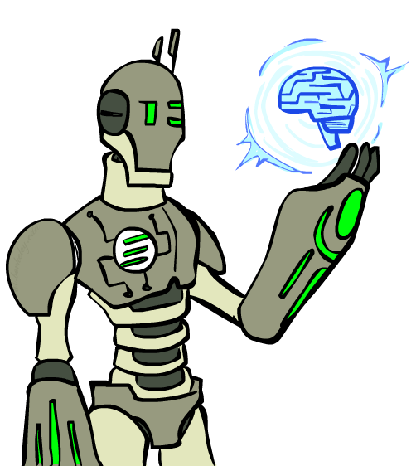
Today
What is artificial intelligence?
What can AI do?
What is this course?

Slide 8
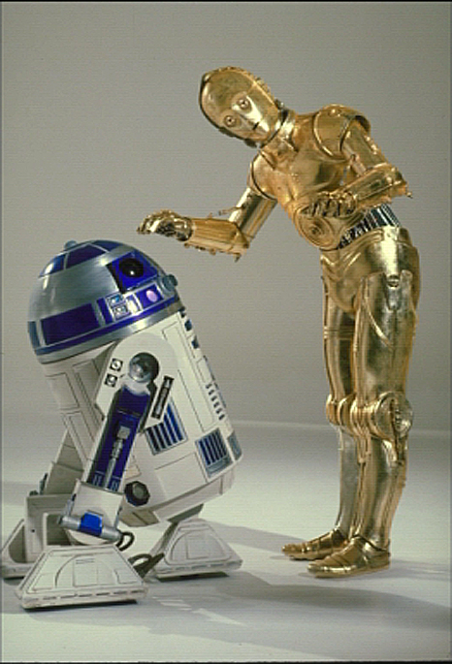

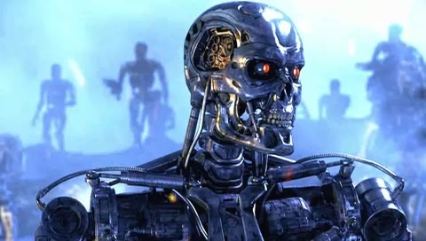
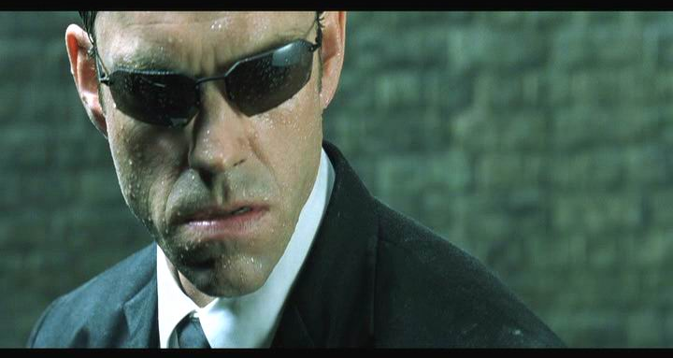
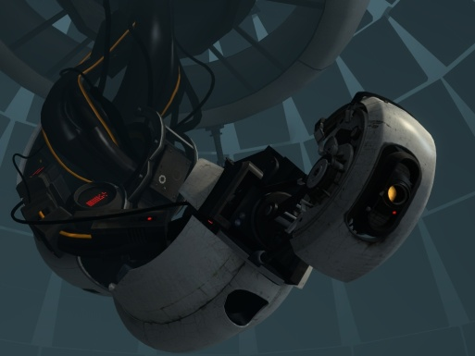
Sci-Fi AI?
Notes:
Who are these? C3PO, what does he do? Essentially google translate, (but with anxiety disorder!)
Smal guy? R2D2 – what does he do, yeah, not so sure
Things got darker: machines come back from the future – to kill us!
90’s : software is scary
Basic fear about what technology might do ?
What if we can’t even tell technology apart from ourselves?
OR maybe it’ll look really different and snarky
Some exceptions like wall-E, positive view of technology (but maybe not of us humans!)
But mostly a worry
[not very worried myself, at least at present]

Slide 9
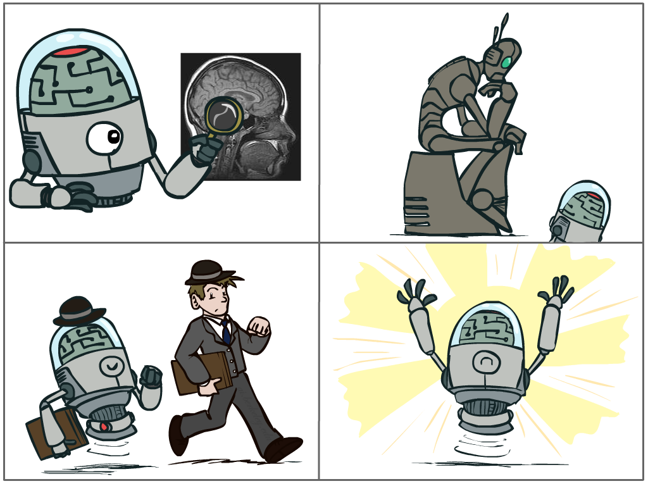
What is AI?
The science of making machines that:
Think like people
Think rationally
Act like people
Act rationally
Notes:
Top left: Think like people --- cognitive science, neuroscience
Bottom left: act like people --- actually very early definition, dating back to Alan Turing --- Turing test; problem to do really well you start focusing on things like don’t answer too quickly what the square root of 1412 is, don’t spell too well, and make sure you have a favorite movie etc. So it wasn’t really leading us to build intelligence
Think rationally – long tradition dating back to Aristotle --- but not a winner, because difficult to encode how to think, and in the end it’s not about how you think, it’s about how you end up acting

Slide 10
Rational Decisions
We’ll use the term rational in a very specific, technical way:
Rational: maximally achieving pre-defined goals
Rationality only concerns what decisions are made
(not the thought process behind them)
Goals are expressed in terms of the utility of outcomes
Being rational means maximizing your expected utility
A better title for this course would be:
Computational Rationality
Notes:
Example of utilities. 10 for A, 1 for each Friday with friends

Slide 11
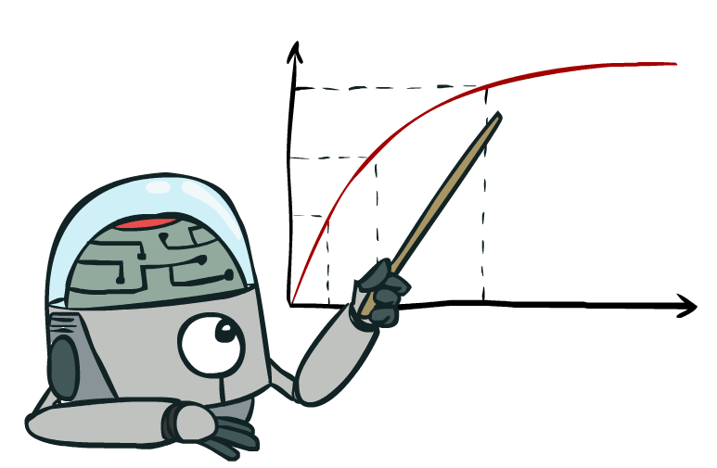
Maximize Your
Expected Utility

Slide 12
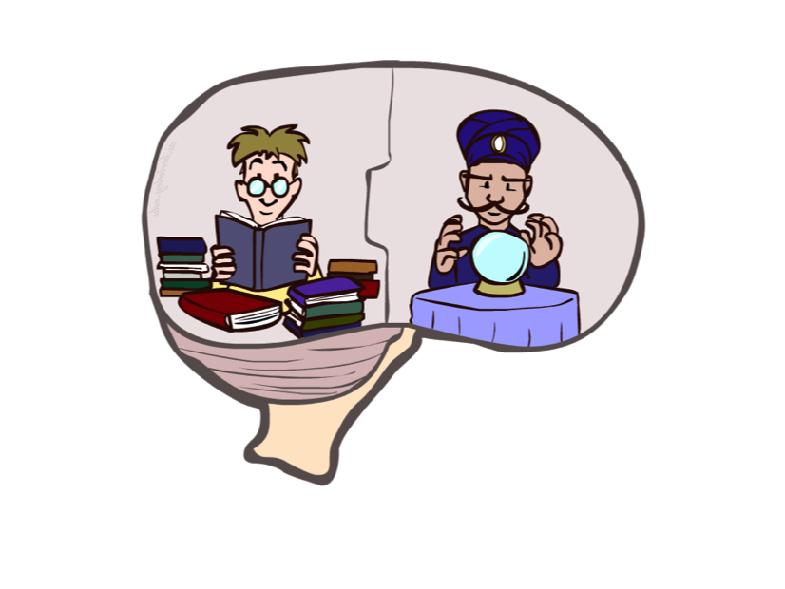
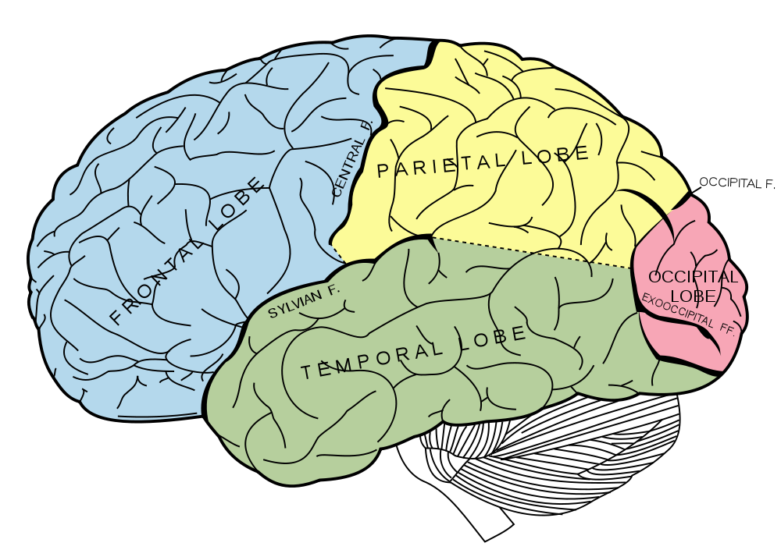
What About the Brain?
Brains (human minds) are very good at making rational decisions, but not perfect
Brains aren’t as modular as software, so hard to reverse engineer!
“Brains are to intelligence as wings are to flight”
Lessons learned from the brain: memory and simulation are key to decision making

Slide 13
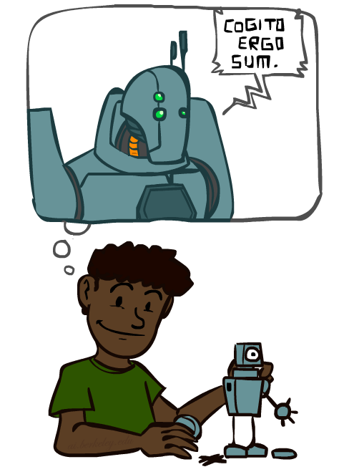
A (Short) History of AI
Demo: HISTORY – MT1950.wmv

Slide 14
Notes:
Thinking machines video --- interviews from back when computers were in the very early years; starting to realize can do something else than arithmetic ; asking where things are headed; many famous people

Slide 15
A (Short) History of AI
1940-1950: Early days
1943: McCulloch & Pitts: Boolean circuit model of brain
1950: Turing's “Computing Machinery and Intelligence”
1950—70: Excitement: Look, Ma, no hands!
1950s: Early AI programs, including Samuel's checkers program, Newell & Simon's Logic Theorist, Gelernter's Geometry Engine
1956: Dartmouth meeting: “Artificial Intelligence” adopted
1965: Robinson's complete algorithm for logical reasoning
1970—90: Knowledge-based approaches
1969—79: Early development of knowledge-based systems
1980—88: Expert systems industry booms
1988—93: Expert systems industry busts: “AI Winter”
1990—: Statistical approaches
Resurgence of probability, focus on uncertainty
General increase in technical depth
Agents and learning systems… “AI Spring”?
2000—: Where are we now?
Notes:
Million dollar computer with less computation than your phone
MT was

Slide 16
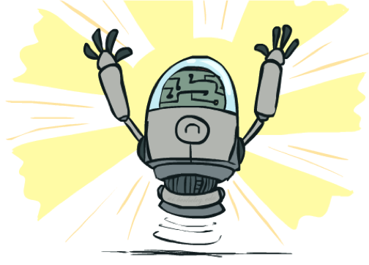
What Can AI Do?
Quiz: Which of the following can be done at present?
Play a decent game of table tennis?
Play a decent game of Jeopardy?
Drive safely along a curving mountain road?
Drive safely along Telegraph Avenue?
Buy a week's worth of groceries on the web?
Buy a week's worth of groceries at Berkeley Bowl?
Discover and prove a new mathematical theorem?
Converse successfully with another person for an hour?
Perform a surgical operation?
Put away the dishes and fold the laundry?
Translate spoken Chinese into spoken English in real time?
Write an intentionally funny story?

Slide 17
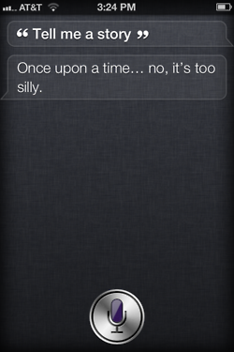
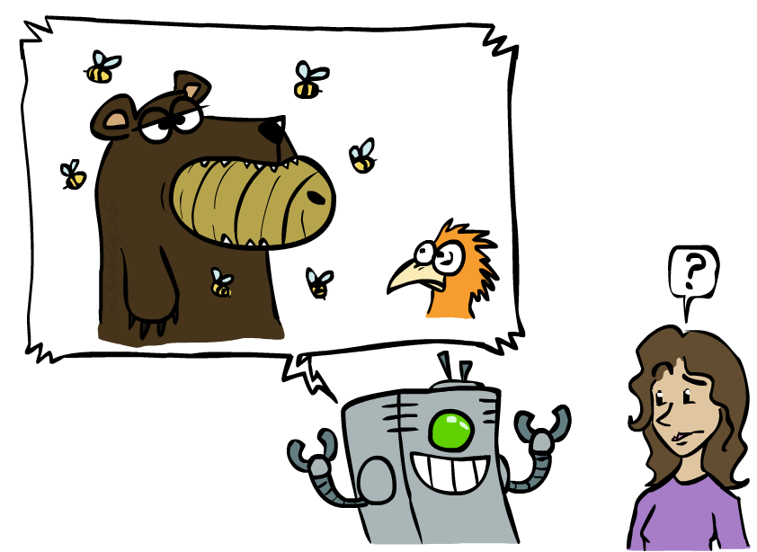
Unintentionally Funny Stories
One day Joe Bear was hungry. He asked his friend
Irving Bird where some honey was. Irving told him
there was a beehive in the oak tree. Joe walked to
the oak tree. He ate the beehive. The End.
Henry Squirrel was thirsty. He walked over to the
river bank where his good friend Bill Bird was sitting.
Henry slipped and fell in the river. Gravity drowned.
The End.
Once upon a time there was a dishonest fox and a vain crow. One day the crow was sitting in his tree, holding a piece of cheese in his mouth. He noticed that he was holding the piece of cheese. He became hungry, and swallowed the cheese. The fox walked over to the crow. The End.
[Shank, Tale-Spin System, 1984]
Notes:
1 – physically wrong, shouldn’t eat beehive
2 – forgot that in drowning not the force is most important but the drownee
3 – not physically wrong, not wrong in a language way, but wrong in the sense that it’s not aware of what is relevant to communicate and what is not
Siri – is that progress?

Slide 18
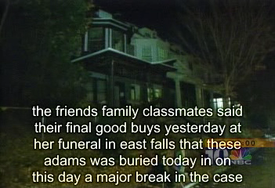
Natural Language
Speech technologies (e.g. Siri)
Automatic speech recognition (ASR)
Text-to-speech synthesis (TTS)
Dialog systems
Demo: NLP – ASR tvsample.avi
Notes:
NLP – ASR tvsample.avi

Slide 20
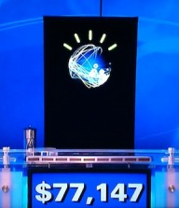
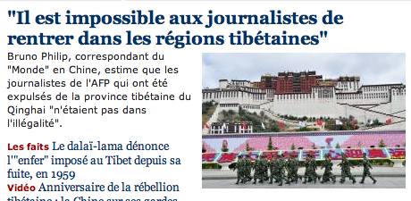
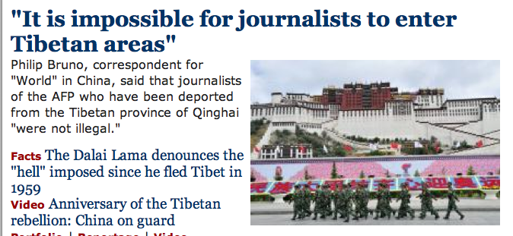
Natural Language
Speech technologies (e.g. Siri)
Automatic speech recognition (ASR)
Text-to-speech synthesis (TTS)
Dialog systems
Language processing technologies
Question answering
Machine translation
Web search
Text classification, spam filtering, etc…

Slide 21
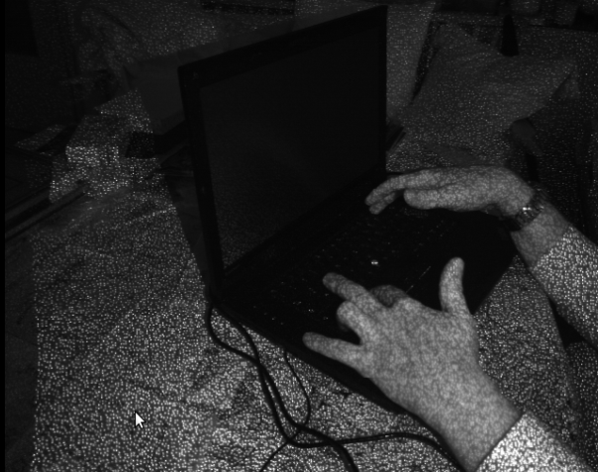

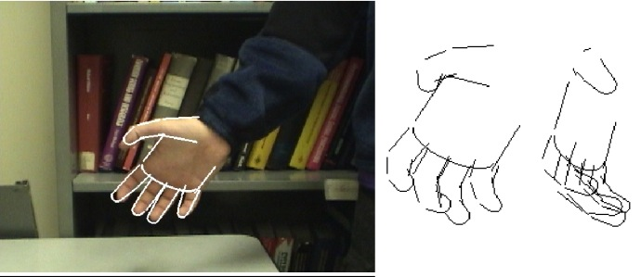
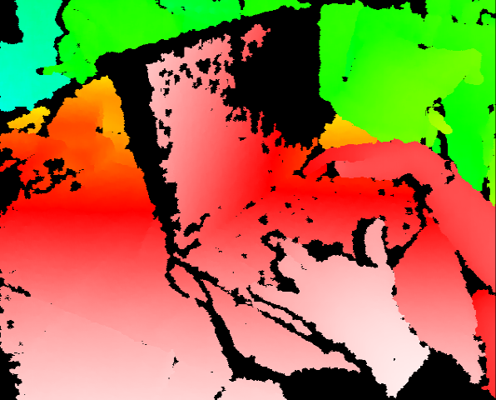
Vision (Perception)
Object and face recognition
Scene segmentation
Image classification
Demo1: VISION – lec_1_t2_video.flv
Images from Erik Sudderth (left), wikipedia (right)
Demo2: VISION – lec_1_obj_rec_0.mpg

Slide 24
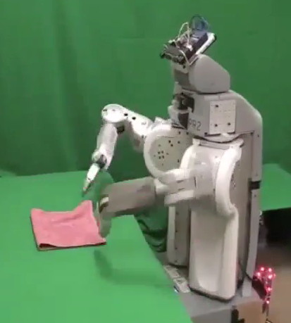
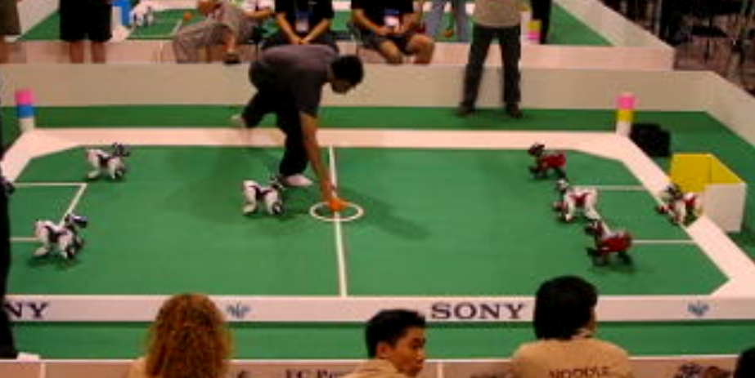
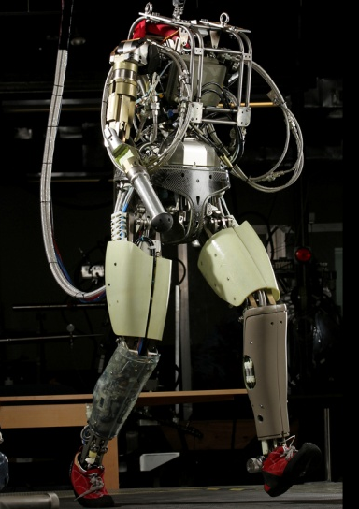
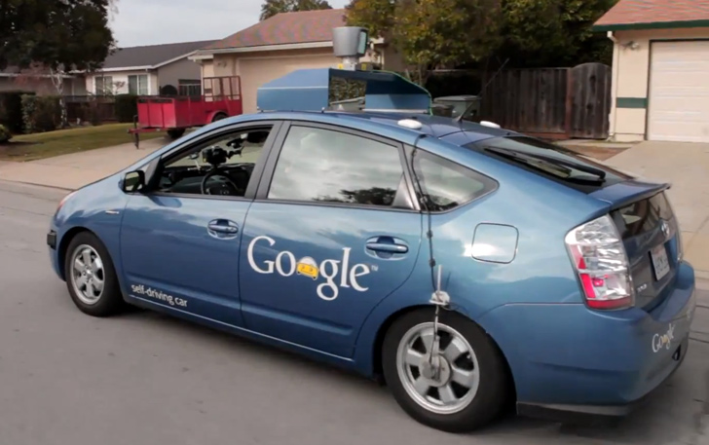
Robotics
Demo 1: ROBOTICS – soccer.avi
Demo 4: ROBOTICS – laundry.avi
Demo 2: ROBOTICS – soccer2.avi
Demo 5: ROBOTICS – petman.avi
Demo 3: ROBOTICS – gcar.avi
Robotics
Part mech. eng.
Part AI
Reality much
harder than
simulations!
Technologies
Vehicles
Rescue
Soccer!
Lots of automation…
In this class:
We ignore mechanical aspects
Methods for planning
Methods for control
Images from UC Berkeley, Boston Dynamics, RoboCup, Google

Slide 30
Logic
Logical systems
Theorem provers
NASA fault diagnosis
Question answering
Methods:
Deduction systems
Constraint satisfaction
Satisfiability solvers (huge advances!)
Image from Bart Selman

Slide 31
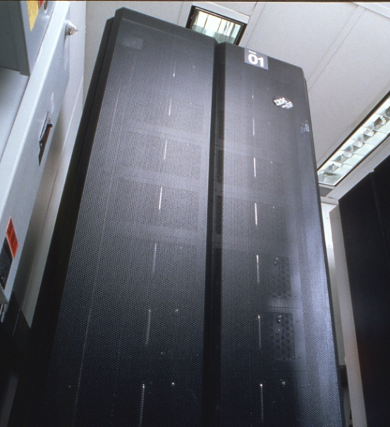
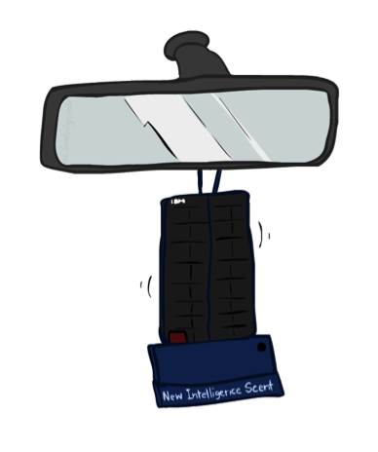
Game Playing
Classic Moment: May, '97: Deep Blue vs. Kasparov
First match won against world champion
“Intelligent creative” play
200 million board positions per second
Humans understood 99.9 of Deep Blue's moves
Can do about the same now with a PC cluster
Open question:
How does human cognition deal with the
search space explosion of chess?
Or: how can humans compete with computers at all??
1996: Kasparov Beats Deep Blue
“I could feel --- I could smell --- a new kind of intelligence across the table.”
1997: Deep Blue Beats Kasparov
“Deep Blue hasn't proven anything.”
Huge game-playing advances recently, e.g. in Go!
Text from Bart Selman, image from IBM’s Deep Blue pages
Notes:
Yeah, Kasparov comment probably says more about humans than about computers

Slide 32

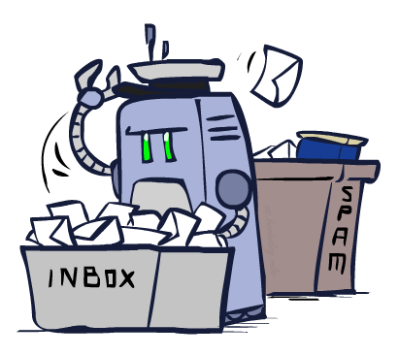
Decision Making
Applied AI involves many kinds of automation
Scheduling, e.g. airline routing, military
Route planning, e.g. Google maps
Medical diagnosis
Web search engines
Spam classifiers
Automated help desks
Fraud detection
Product recommendations
… Lots more!
Notes:
All applications can be thought of as decision making or useful sub-components of decision making

Slide 33
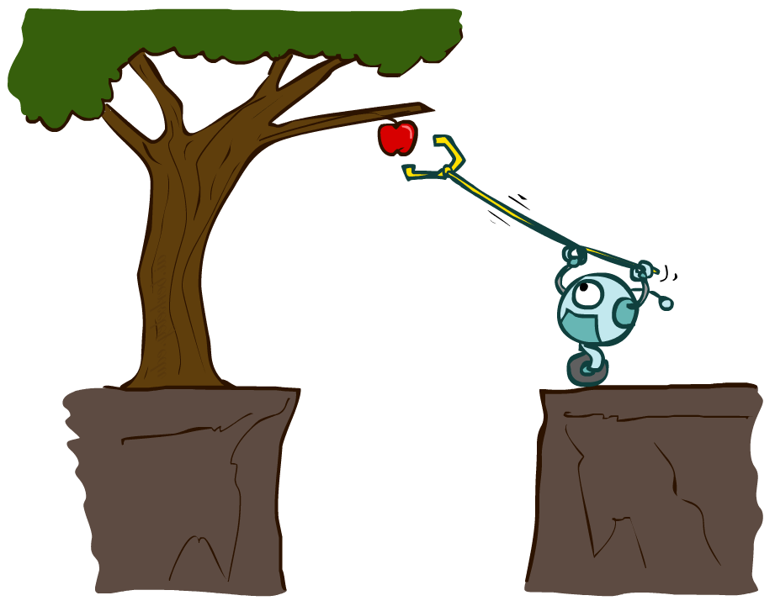
Designing Rational Agents
An agent is an entity that perceives and acts.
A rational agent selects actions that maximize its (expected) utility.
Characteristics of the percepts, environment, and action space dictate techniques for selecting rational actions
This course is about:
General AI techniques for a variety of problem types
Learning to recognize when and how a new problem can be solved with an existing technique
Sensors
Agent
Percepts
Environment
?
Actuators
Actions

Slide 34
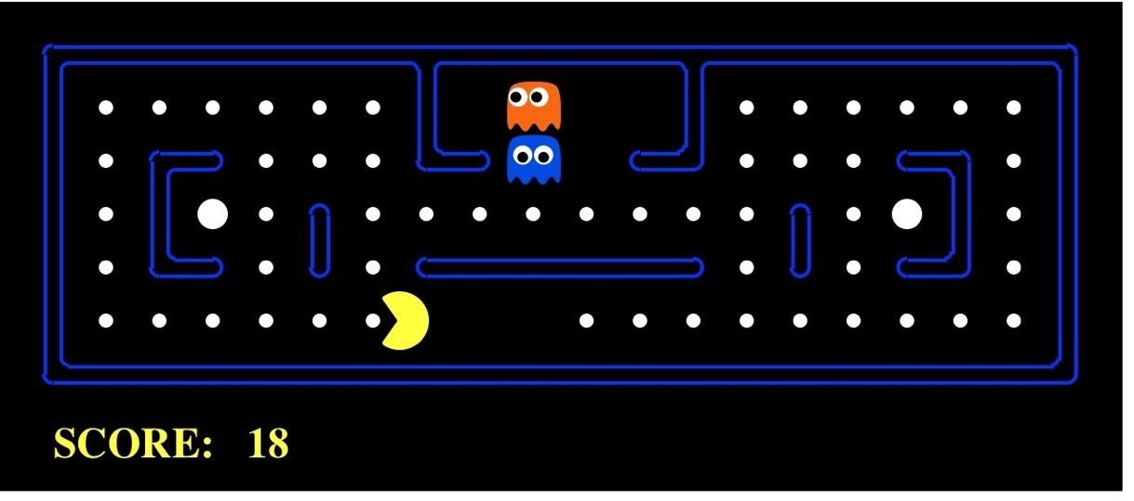
Pac-Man as an Agent
Agent
Environment
Sensors
Percepts
?
Actuators
Actions
Pac-Man is a registered trademark of Namco-Bandai Games, used here for educational purposes
Demo1: pacman-l1.mp4 or L1D2
Notes:
L1D2 =
python demos.py
Select Lecture 1 → select demo 2

Slide 35
Course Topics
Part I: Making Decisions
Fast search / planning
Constraint satisfaction
Adversarial and uncertain search
Part II: Reasoning under Uncertainty
Bayes’ nets
Decision theory
Machine learning
Throughout: Applications
Natural language, vision, robotics, games, …

